Slide 1
SURREY EDGE CHAPTER

Slide 2
Mike Woodhouse
“we love what we do”
Professional DJ Service, serving the Lower Mainland. Specializing in weddings and special events.

Slide 3
Kristopher ‘Kit’ Hulbert
“Keep your biggest asset protected with exterior housing cleaning services from Shack Shine.”
Our exterior house cleaning services in Vancouver, BC will have your home looking it’s best. When you see the end result, you’ll know we do the job right the first time.

Slide 4
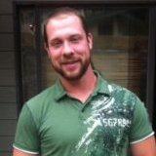
James Drager
“ high quality, high value”
Serving residential and commercial plumbing and heating needs in Surrey, Vancouver, Burnaby, Coquitlam, North Vancouver, Langley, Port Coquitlam, Port Moody and Richmond.

Slide 5
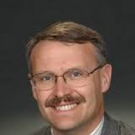
Daniel Olson
“to assist each client develop a portfolio of investments and insurance so no matter what happens, they will be Okay!”
Assisting my client achieve lifelong financial security through investment and insurance solutions. Ensuring that your business legacy is enjoyed by your family, not revenue Canada.

Slide 6
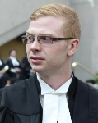
Bear Creek Law LLP
Mikhael Magaril
“the consultations are free – the results are priceless”
The lawyers at Bear Creek Law LLP recognize that every client and file is unique. The lawyers at Bear Creek Law LLP practice in a wide variety of litigation areas.

Slide 7
Scott Porter
“making sense of investing”
As an Edward Jones financial advisor, I believe it’s important to invest my time to understand what you’re working toward before you invest your money.

Slide 8
Matt Johnson
“find your dream home now”
I will help you complete your financing and inspections, and close on the transaction. My top priority is to make sure that your home buying experience is pleasant, cost-efficient, and successful.

Slide 9
Vista Bookeeping
&
Consulting
Chris Erickson
“helping you see beyond the numbers”
Vista Bookkeeping & Consulting is a full cycle bookkeeping firm in Langley, BC that will help business owners organize, understand and grow their business so that they see their finances with clarity and freedom from stress.

Slide 10
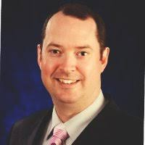
Leon Sharp
“Like it never even happened”
SERVPRO of Langley Professionals provide fire and water damage restoration services. Our company proudly serves the Vancouver Lower mainland and surrounding areas.

Slide 11
Jackie Whitaker
“ effectively multi-tasks and balances customer needs with company demands”
Attention to detail, professionalism and interpersonal skills are a few components that make a trusted advisor for retail leasing and sales.

Slide 12
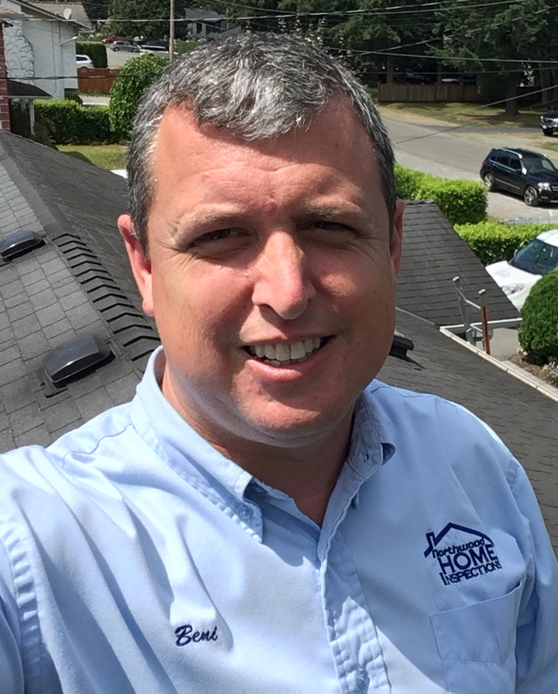
Beni Bennett
“working for you when it matters the most”
Family owned. Community Focused
Redefining the expertise of home inspections, one house at a time.

Slide 13
Angel Smith
“our policy is your protection”
My business is to educate my clients and provide them with a policy that will respond in the event of a claim. Protect your assets with a policy that values your premium.

Slide 14
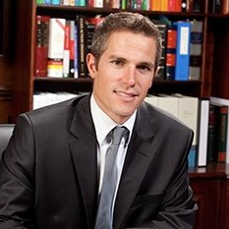
Michael Carter
“we provide quality services in a timely fashion at a reasonable cost”
Cleveland Doan LLP was established in 1995. We are located in White Rock British Columbia and provide legal solutions to clients located throughout the lower mainland, as well as nationally and internationally.

Slide 15
Brent Murphy
“When life leaves you in the dark … let BPM turn you on”
BPM Electric Ltd. has been serving BC’s lower-mainland since 1987. We are all over the Lower mainland and available to service all your electrical needs.

Slide 16
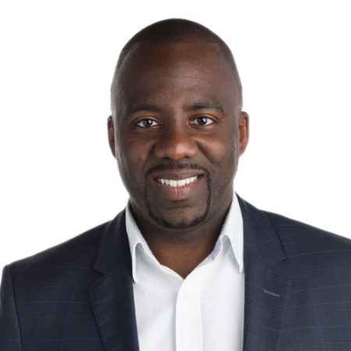
Shaun Francis
“customized solutions. Period.”
Providing customized mortgage options and solutions for his clients including first time homebuyers, investors, business owners, new immigrants, and builders.

Slide 17
Pawanjit Sohi
“Helping you keep your hard earned money”
We are a full service CA firm providing all types of accounting, assurance, consulting and taxation advice to help you save money and prosper. Remember, initial consultations are free of charge, so feel free to contact us to discuss what's keeping you up at night.

Slide 18
SURREY EDGE CHAPTER
We are always looking for new members!

